Slide 1
Presentation brief for MCT’s
Title of presentation | Introduction to Azure Machine Learning
Presentation length | 120 minutes (including labs)
Audience | Data Scientists planning to operate machine learning workloads on Azure
Purpose | Introduce Azure Machine Learning workspaces and how to create them Describe how to use tools to work with Azure Machine Learning workspaces
(think) Student key takeaways | Azure Machine Learning workspaces contain machine learning assets You can work with workspaces using Azure Machine Learning specific tools, or from any Python development environment
(feel) Student desired mindset | Comfortable with the concepts of Azure Machine Learning workspaces and experiments Confident using Azure Machine Learning studio and the Azure ML SDK to connect to a workspace and view assets
(do) Student outcomes | Create an Azure Machine Learning workspace and manage its assets in Azure Machine Learning Studio Connect to an Azure Machine Learning workspace from a Python development environment outside of the workspace
More information | For course feedback, please use the MCT Forums

Slide 2

Module 1: Introduction to Azure Machine Learning

Slide 3
Agenda
Getting Started with Azure Machine Learning
Azure Machine Learning Tools

Slide 4


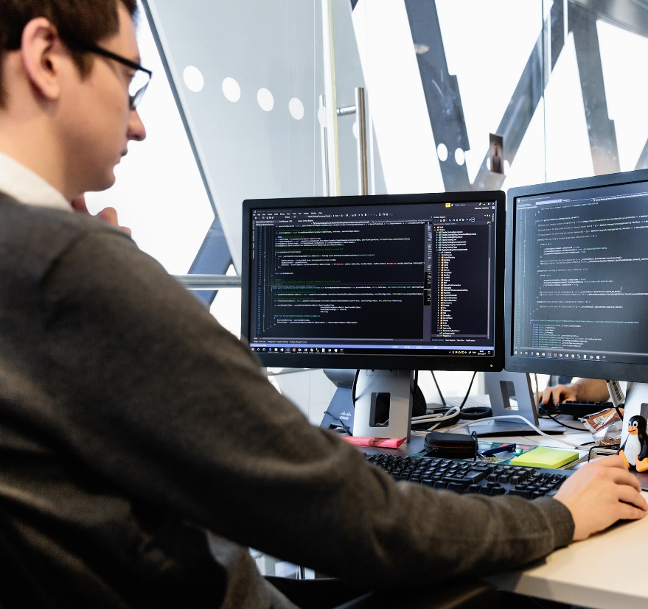
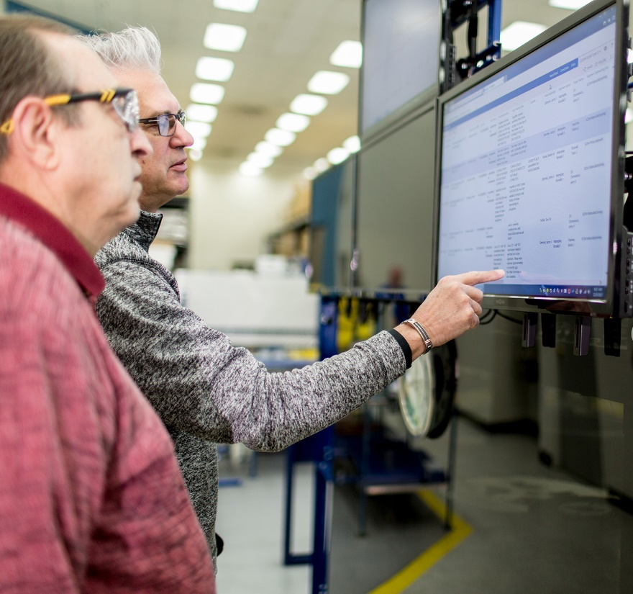



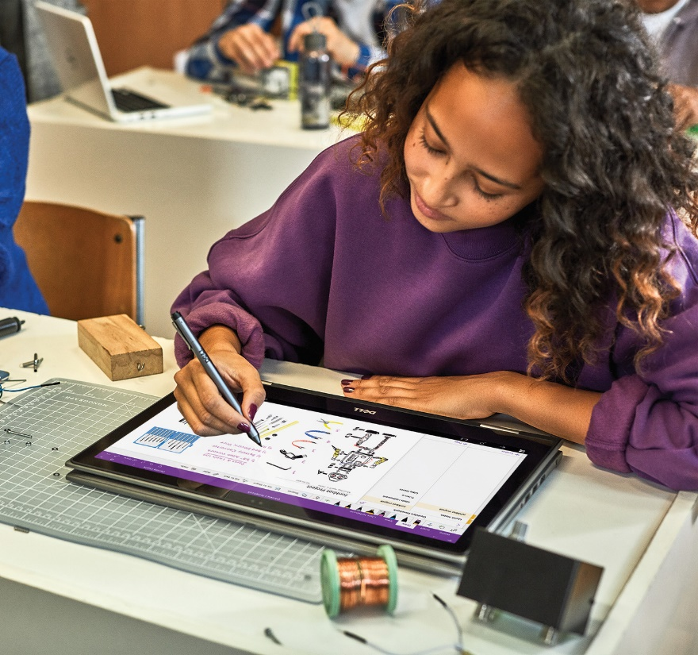


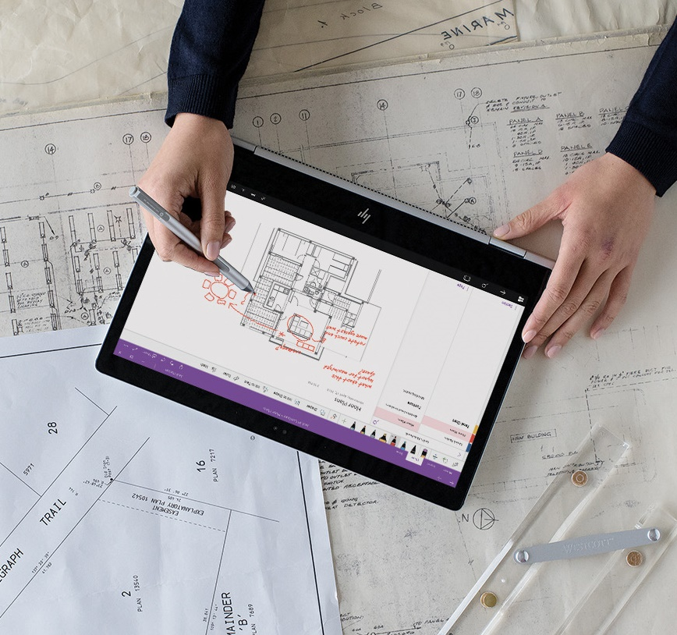


Lesson 1
Getting Started with Azure Machine Learning
Data
Cloud
AI

Slide 5











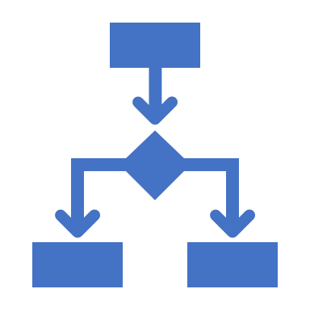



What is Azure Machine Learning?
A platform for operating machine learning workloads in the cloud
Azure Machine Learning
Scalable, on-demand compute
Data storage and connectivity
ML workflow orchestration
Model registration and management
Metrics and monitoring
Model deployment
Microsoft Azure

Slide 6


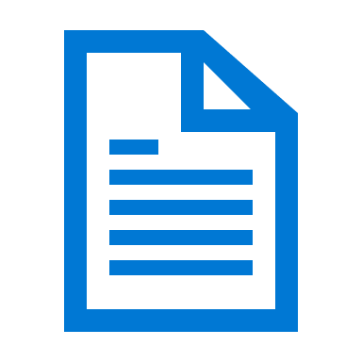






Azure Machine Learning Workspaces
Microsoft Azure
Subscription
Resource Group
Workspace
Storage Account
Application Insights
Key Vault
Virtual Machines
Container Registry
Compute
Notebooks
Pipelines
Data
Experiments
Models

Slide 7



Considerations for Creating a Workspace
Region
Edition
Check Azure Resource availability
For example, NC-Series Virtual Machines for GPU processing
Enterprise
All features
Basic
No Visual Designer
No Automated ML user interface
No Data Drift user interface

Slide 8
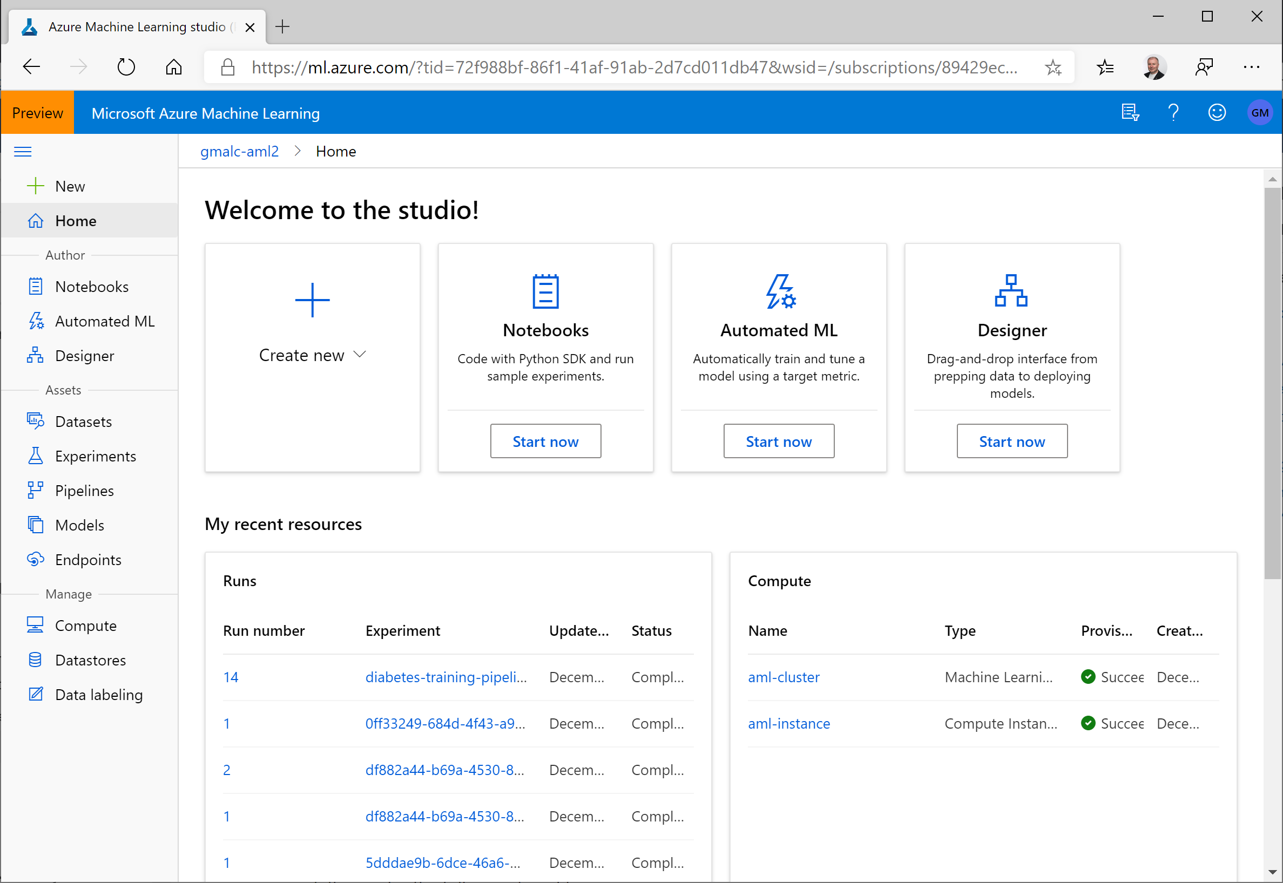
Azure Machine Learning studio
Manage compute and data
Run experiments
View metrics
Manage and deploy models
Manage endpoints
Use graphical modeling tools:
Designer - "no-code" model development
Automated Machine Learning - find the best model for your data

Slide 9
Lab 1A
Creating an Azure Machine Learning Workspace
https://aka.ms/msl-dp100

Slide 10
Lesson Review
Complete the Review Questions

Slide 11
Lesson 2
Azure Machine Learning Tools
Data
Cloud
AI

Slide 12
The Azure Machine Learning SDK for Python
Code-based configuration for machine learning assets:
Automate repeatable asset creation
Ensure consistency across development, test, and production environments
Incorporate machine learning asset configuration into DevOps
pip install azureml-sdk
from azureml.core import Workspace
ws = Workspace.from_config()
for compute_name in ws.compute_targets:
compute = ws.compute_targets[compute_name]
print(compute.name, ":", compute.type)

Slide 13
Azure Machine Learning CLI Extension
Azure Machine Learning commands for the Azure CLI
Cross-platform command-line management of Azure Machine Learning assets
az extension add -n azure-cli-ml
az ml computetarget list -g 'aml-resources' -w 'aml-workspace'

Slide 14
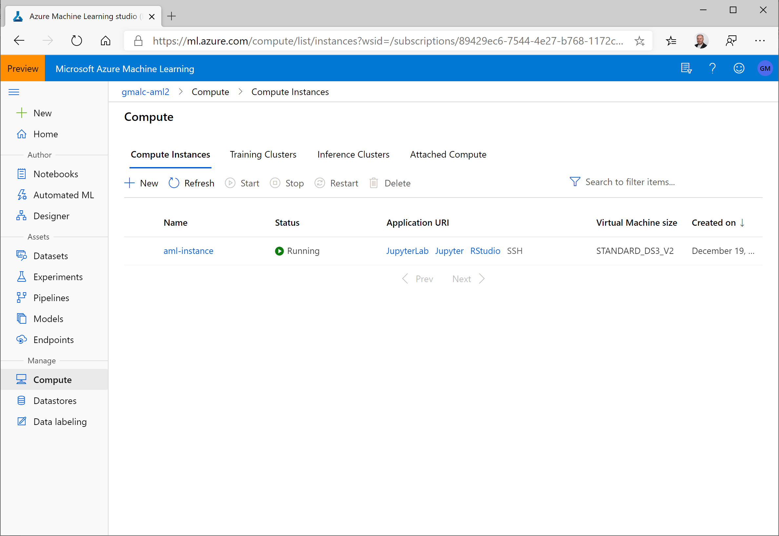
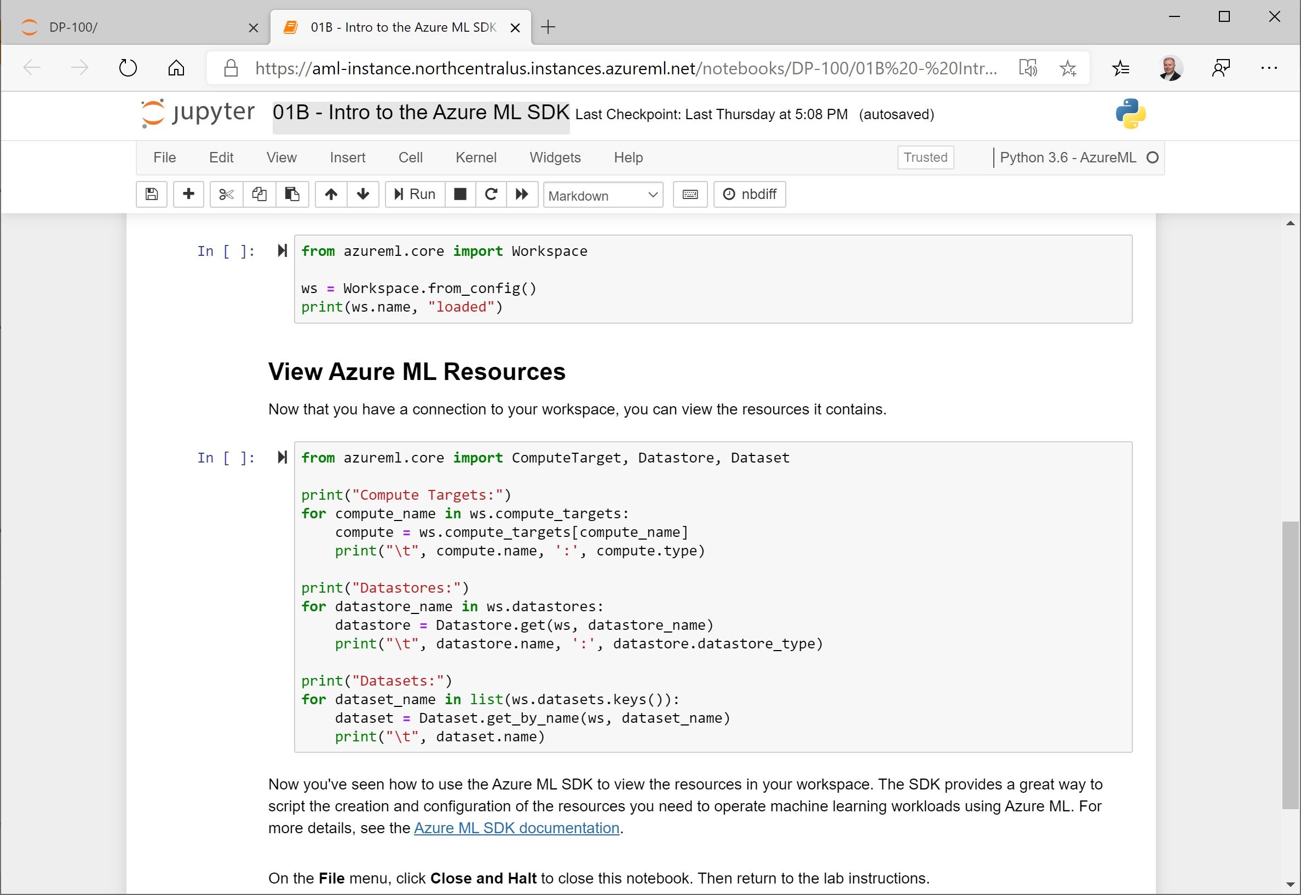
Compute Instances
Jupyter Notebook and JupyterLab servers in your workspace
Choose the compute specifications you need

Slide 15
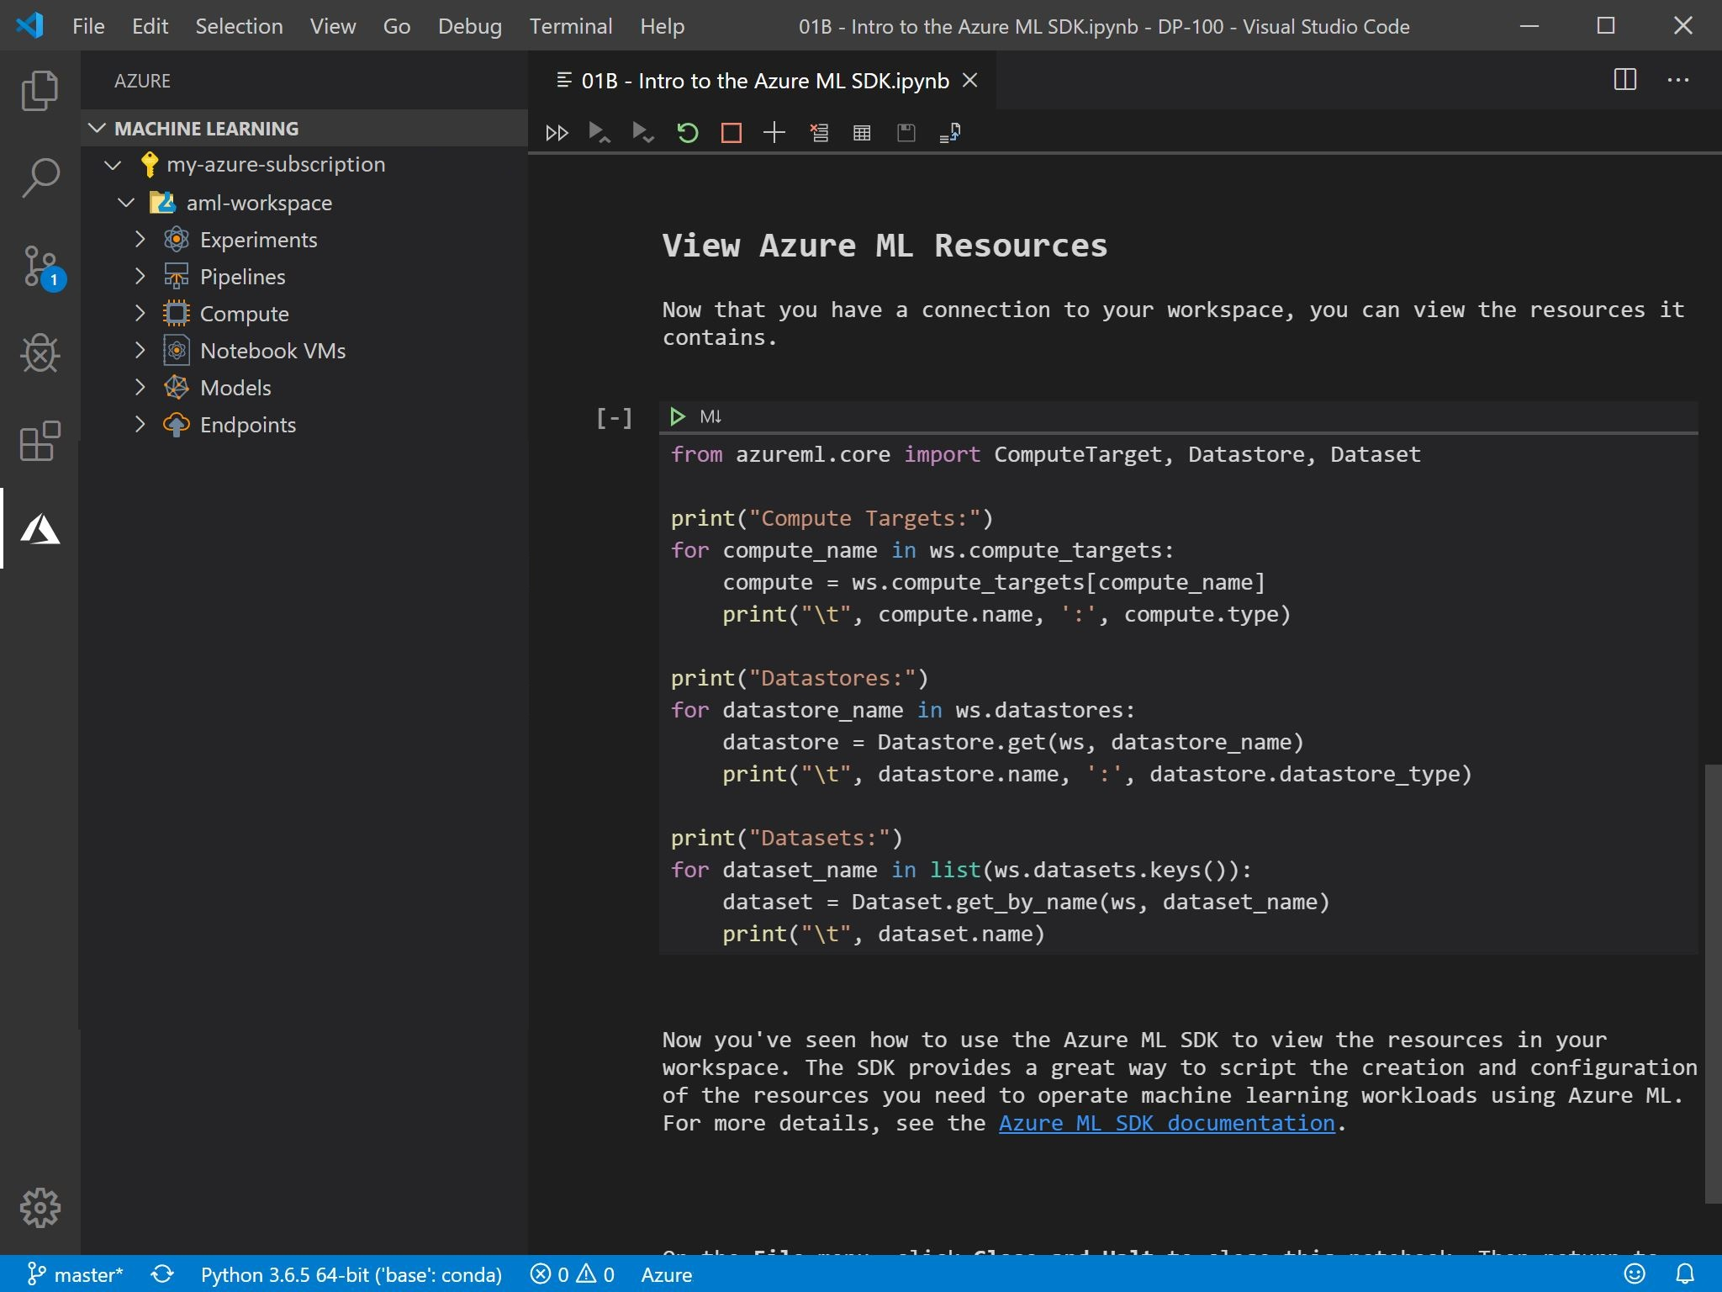
The Azure Machine Learning Extension for VS Code
Graphical Interface for working with Azure Machine Learning
When combined with the Python extension, a complete development environment for Azure Machine Learning

Slide 16
Lab 1B
Working with Azure Machine Learning Tools
https://aka.ms/msl-dp100

Slide 17
Lesson Review
Complete the Review Questions

